Slide 1
Problem Solving
What is it?
Do I have it?
Can I develop it?

Slide 2
What is it?
Problem Solving: the process of finding solutions to difficult or complex issues.*
What is one problem you had today before you left your “home”?
How did you solve the problem?
Can you evaluate the process you used this morning and give feedback on how to do it differently the next time you encounter that same type of problem?
*Source: Oxford Languages - https://languages.oup.com/google-dictionary-en/

Slide 3
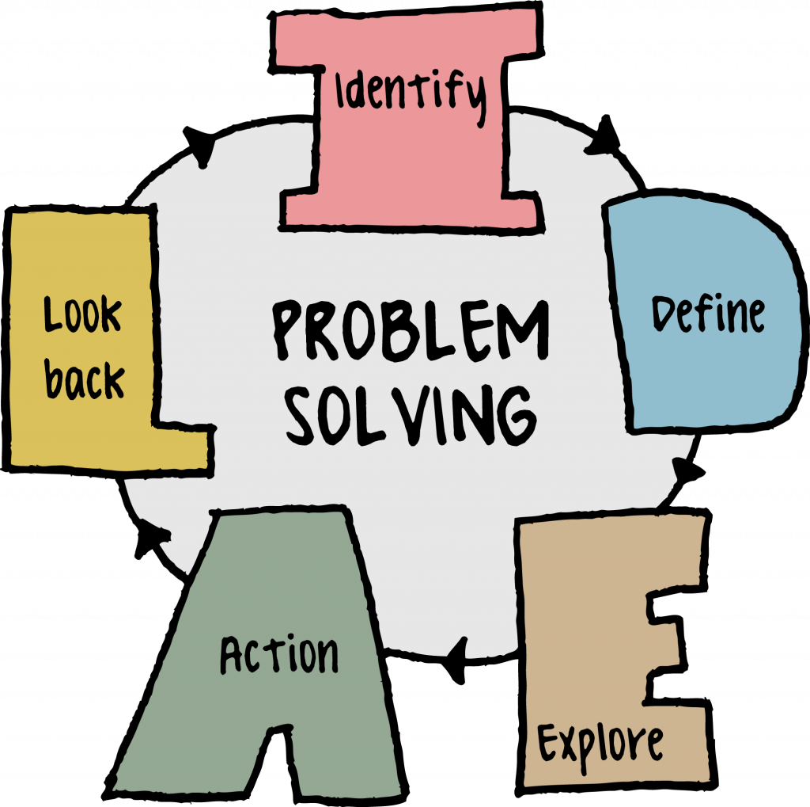
Do I have it? → IDEAL
1. Realize there is a problem.
2. Define the problem.
3. What are the possible outcomes?
- What outcome do YOU want?
4. Make a plan
- What steps have to be taken?
5. Reflect on how you handled that problem and define actionable
https://uta.pressbooks.pub/industrialengineeringintro/chapter/what-is-problem-solving/

Slide 4
Can you problem solve?
Let’s Practice… write this down or type it out.
What is your career goal? I want to work in…. I want to be a….
What do you need to do to achieve this goal? I need to have …(insert degree or major, experiences)
What resource do you require? College degree? Graduate? Internships?
Over what time period and in what sequence will this happen?

